Slide 1


Nitte Meenakshi Institute of Technology
(AN AUTONOMOUS INSTITUTION AFFILIATED TO VISVESVARAYA TECHNOLOGICAL UNIVERSITY, BELGAUM)
PB No. 6429, Yelahanka, Bangalore 560-064, Karnataka
Telephone: 080- 22167800, 22167860, Fax: 080 - 22167805
Department of Computer Science and Engineering
( NBA Accredited till 2020)
Car Fleet Management
19CSP15
Presentation By:
Prashant Shah 1NT16CS214
Ankit Prasad Gupta 1NT16CS216
Bivek Kumar Shah 1NT16CS192
Sahib Ramnani 1NT16CS171
Guided By:
Dr. Venkatesh. K.
Professor,
Department of Computer Science & Engineering

Slide 2
Nitte Meenakshi Institute of Technology (AN AUTONOMOUS INSTITUTION AFFILIATED TO VISVESVARAYA TECHNOLOGICAL UNIVERSITY, BELGAUM) PB No. 6429, Yelahanka, Bangalore 560-064, Karnataka Telephone: 080- 22167800, 22167860, Fax: 080 - 22167805 Department of Computer Science and Engineering ( NBA Accredited till 2020)
Background
Fleet Management is the process in which fleet and asset information is managed in proper way by which it enables the company to reduce the cost, improve efficiency and ensure compliance across an entire fleet operation. [6]
Car Fleet Management (CFM) allows any organization like Zoom Car, Ola, Uber to monitor the condition of the vehicle and manage it in a proper way. Like the existing Truck Fleet Management system this will provide beneficial result to the car leasing organizations. It also has some additional features relevant to car fleet management.

Slide 3
Nitte Meenakshi Institute of Technology (AN AUTONOMOUS INSTITUTION AFFILIATED TO VISVESVARAYA TECHNOLOGICAL UNIVERSITY, BELGAUM) PB No. 6429, Yelahanka, Bangalore 560-064, Karnataka Telephone: 080- 22167800, 22167860, Fax: 080 - 22167805 Department of Computer Science and Engineering ( NBA Accredited till 2020)
Background
Rapid advance and adoption of technologies associated with Internet of Things has resulted in the availability of sophisticated miniaturized sensors and processing elements available for the Automotive platform also. The CFM system is built using the IOT platform. In addition, some of the features like information on driving habits of specific drivers, eye blinking patterns among others can benefit from the use of Machine Learning algorithms to detect unusual behaviour patterns and provide warnings for suitable corrective measures to be implemented.

Slide 4
Nitte Meenakshi Institute of Technology (AN AUTONOMOUS INSTITUTION AFFILIATED TO VISVESVARAYA TECHNOLOGICAL UNIVERSITY, BELGAUM) PB No. 6429, Yelahanka, Bangalore 560-064, Karnataka Telephone: 080- 22167800, 22167860, Fax: 080 - 22167805 Department of Computer Science and Engineering ( NBA Accredited till 2020)
Research motivation and Problem Statement
Car lease company like zoom are facing a lot of challenges in order to track and know the condition of their vehicle. They are also busy maintaining the record and authorizing the driver.
By seeing these difficulties and with the rapidly growing technology Internet of things(IOT). We came across to the solution to automate the manual process and to use the truck fleet management concept to the car fleet management.
Car lease company like Zoom, Ola Rental, Uber are facing a lot of challenges in order to track and know the condition of their vehicle. They are also busy maintaining the record and authorizing the driver. By seeing these difficulties and with the rapidly growing technology Internet of things (IOT). We proposed to the solution to automate the manual process and to use the truck fleet management concept to the car fleet management. By this it can help the company to manage their car fleet and keep it safe from the fraudulent drivers.

Slide 5
Nitte Meenakshi Institute of Technology (AN AUTONOMOUS INSTITUTION AFFILIATED TO VISVESVARAYA TECHNOLOGICAL UNIVERSITY, BELGAUM) PB No. 6429, Yelahanka, Bangalore 560-064, Karnataka Telephone: 080- 22167800, 22167860, Fax: 080 - 22167805 Department of Computer Science and Engineering ( NBA Accredited till 2020)
Research motivation and Problem Statement
There are a lot of things that can go wrong with vehicle such as Driver Making unwanted stops, driving recklessly, not taking the best routes, or wasting energy. That were not able to be tracked using legacy systems and technology can now be harnessed to track these. The IoT platform will have sensors for:
Positioning sensing (GPS Tracking)
Geofencing
Vehicle Power control (On/Off)
Drowsiness Detection
Ultrasonic Parking
Speed Monitoring
Automatic Wiper Control

Slide 6
Nitte Meenakshi Institute of Technology (AN AUTONOMOUS INSTITUTION AFFILIATED TO VISVESVARAYA TECHNOLOGICAL UNIVERSITY, BELGAUM) PB No. 6429, Yelahanka, Bangalore 560-064, Karnataka Telephone: 080- 22167800, 22167860, Fax: 080 - 22167805 Department of Computer Science and Engineering ( NBA Accredited till 2020)
Research Objectives
Track live location of the car and checks if he/she cross the boundary of geofenced area.
Turn on/off the main power supply of the car.
Monitor the behavior of the driver by detecting drowsiness.
Monitor speed of the car and automate the wiper.
Park the car very efficiently without any collision.
Build the system by which above mentioned things are possible to implement and provide the best result for the car leasing company like Zoom car, Ola, Uber.

Slide 7
Nitte Meenakshi Institute of Technology (AN AUTONOMOUS INSTITUTION AFFILIATED TO VISVESVARAYA TECHNOLOGICAL UNIVERSITY, BELGAUM) PB No. 6429, Yelahanka, Bangalore 560-064, Karnataka Telephone: 080- 22167800, 22167860, Fax: 080 - 22167805 Department of Computer Science and Engineering ( NBA Accredited till 2020)
Literature Survey
The paper [1] described Intelligent Transportation System (ITS) consists of three components; the sensor system, monitoring system and the display system. Using GPS, NFC, Temperature and Humidity sensor they take every sensors data. Such sensors are connected to the server through IP address and port number. It uses HTTP protocol for request and response. With the successful connection of servers, databases (location DB, Commuter DB, Ambience DB) accept the value from the sensors. The webpage is designed with PHP which receive information from sensor and redirects the values to their respective server database through GSM module. Information Processing Systems (IPS) converts raw data (sensor data) into context data (meaningful useful data) and provide information to the bus driver.

Slide 8
Nitte Meenakshi Institute of Technology (AN AUTONOMOUS INSTITUTION AFFILIATED TO VISVESVARAYA TECHNOLOGICAL UNIVERSITY, BELGAUM) PB No. 6429, Yelahanka, Bangalore 560-064, Karnataka Telephone: 080- 22167800, 22167860, Fax: 080 - 22167805 Department of Computer Science and Engineering ( NBA Accredited till 2020)
Literature Survey
The paper [2] explained the methodology of monitoring the fuel level and correlate it with the distance by the vehicle. This can also help in stopping pilferage of fuel. Here, firstly fuel level sensor and GPS based odometer sends the information to the controller. Then, the received data will be converted into transmittable form. Such data will be again sent to the Control database which will be operated with internet in a suitable and convenient medium. Finally, after complete processing the status of the vehicle can be visible onto the Webpage of this application.
The paper [3] proposed “The Real Time Vehicle Fleet Management and Security System” project which is built on a Linux based embedded microprocessor. It uses GPS for vehicle location tracking. GSM-GPRS modem is used for communication whereas for security purpose physical panic button, Biometric sensor, Camera, and speakers are used. “In-Vehicle System” uses embedded Linux cubie truck whose main purpose is to get all the vehicle details using different sensors. “Server System” accept the data from In-Vehicle System and maintain a database to store the accepted data and the GUI server for user interface. For User Interface a dedicated server used for data acquisition and a GUI renderer is created. This GUI-renderer plots and displays the real time data dynamically.

Slide 9
Nitte Meenakshi Institute of Technology (AN AUTONOMOUS INSTITUTION AFFILIATED TO VISVESVARAYA TECHNOLOGICAL UNIVERSITY, BELGAUM) PB No. 6429, Yelahanka, Bangalore 560-064, Karnataka Telephone: 080- 22167800, 22167860, Fax: 080 - 22167805 Department of Computer Science and Engineering ( NBA Accredited till 2020)
Literature Survey
The paper [4] uses Artiﬁcial Intelligence-based advanced algorithms to detect driver fatigue and the rate at which the driver is drowsy. It proposed an algorithm that uses eye and mouth vertical distances, eye closure, yawning and other engineered facial features to detect driver drowsiness.
The paper [5] proposed a system to prevent road accidents and to sense speed of vehicles during road travel and also to transmit data to the cloud. It uses the concept of WSN and IOT. It uses a sim module to transmit the collected information to the cloud. It uses crash sensor to detect the crash and if any emergency occurs it alert the nearby police station and hospital.

Slide 10
Nitte Meenakshi Institute of Technology (AN AUTONOMOUS INSTITUTION AFFILIATED TO VISVESVARAYA TECHNOLOGICAL UNIVERSITY, BELGAUM) PB No. 6429, Yelahanka, Bangalore 560-064, Karnataka Telephone: 080- 22167800, 22167860, Fax: 080 - 22167805 Department of Computer Science and Engineering ( NBA Accredited till 2020)
Functional Requirements
Hardware Requirements
An electric vehicle where CFM can be implemented.
Microcontrollers to process every elements of CFM.
A GPS sensor to monitor car’s location (latitude & longitude).
Four ultrasonic sensors to monitor objects in the close proximity within a range of two meters.
An Accelerometer to monitor the speed of vehicle.

Slide 11
Nitte Meenakshi Institute of Technology (AN AUTONOMOUS INSTITUTION AFFILIATED TO VISVESVARAYA TECHNOLOGICAL UNIVERSITY, BELGAUM) PB No. 6429, Yelahanka, Bangalore 560-064, Karnataka Telephone: 080- 22167800, 22167860, Fax: 080 - 22167805 Department of Computer Science and Engineering ( NBA Accredited till 2020)
Functional Requirements
Hardware Requirements
Relay to control the power supply on/off.
A camera module to monitor driver’s eyes activity for drowsiness detection.
A servo motor to operate automatic wiper when it starts raining.
Buck Converter to step down the DC voltage from the input to the output.
A Display Screen for driver to view all the parameters.

Slide 12
Nitte Meenakshi Institute of Technology (AN AUTONOMOUS INSTITUTION AFFILIATED TO VISVESVARAYA TECHNOLOGICAL UNIVERSITY, BELGAUM) PB No. 6429, Yelahanka, Bangalore 560-064, Karnataka Telephone: 080- 22167800, 22167860, Fax: 080 - 22167805 Department of Computer Science and Engineering ( NBA Accredited till 2020)
Functional Requirements
Software Requirements
A valid updated Raspbian OS installed on Raspberry pi to process every element of CFM.
An Arduino software installed in system to process microcontroller.
Must require a proper Full Stack processing environment to create front end and back end of the software of CFM.
A Firebase real-time database to store, process and evaluate the data.

Slide 13
Nitte Meenakshi Institute of Technology (AN AUTONOMOUS INSTITUTION AFFILIATED TO VISVESVARAYA TECHNOLOGICAL UNIVERSITY, BELGAUM) PB No. 6429, Yelahanka, Bangalore 560-064, Karnataka Telephone: 080- 22167800, 22167860, Fax: 080 - 22167805 Department of Computer Science and Engineering ( NBA Accredited till 2020)
Non-Functional Requirements
Maintainability: This system requires good maintainability care from the organizations. Since, at a time there might be high number of drivers taking car on lease, it definitely requires good maintainability services to maintain the administration dashboard and monitor vehicle.
Reliability: Car Fleet Management must be reliable without any faults and bugs. Every mentioned parameters of the Car Fleet Management should be mentioned and monitored properly in the dashboard.
Scalability: The Firebase real time database must be scalable to adopt high number of drivers’ detail. Since this application requires login usage to be stored in the database, there should be no cases of inconsistency in the scalability of the database.
Security: Since, Car Fleet Management is mainly dependent on Google API and Firebase Real Time database, there is high chance of the data loss due to hackers and attackers. So, the system must be secured by implementing different services like, installing SSL, using anti-malware software, regular backup etc. This is the future implementation of this project.

Slide 14
Nitte Meenakshi Institute of Technology (AN AUTONOMOUS INSTITUTION AFFILIATED TO VISVESVARAYA TECHNOLOGICAL UNIVERSITY, BELGAUM) PB No. 6429, Yelahanka, Bangalore 560-064, Karnataka Telephone: 080- 22167800, 22167860, Fax: 080 - 22167805 Department of Computer Science and Engineering ( NBA Accredited till 2020)
Methodology
System consists of seven modules: GPS Tracking; Geofencing; Vehicle On/Off; Drowsiness Detection; Ultrasonic Parking; Speed Monitoring; Automatic Wiper.
Seven modules of CFM consist of different sensors. Sensors send the data to the IoT gateway. Here, microcontroller process the data of sensor and send it to the Firebase Real-time Database. Firebase Real-time database provide the storage functionality where the data is stored. Finally, the firebase sends the result in the form of data to the dashboard. Dashboard represent the valuable data and provide the result to the user and administrator.

Slide 15
Nitte Meenakshi Institute of Technology (AN AUTONOMOUS INSTITUTION AFFILIATED TO VISVESVARAYA TECHNOLOGICAL UNIVERSITY, BELGAUM) PB No. 6429, Yelahanka, Bangalore 560-064, Karnataka Telephone: 080- 22167800, 22167860, Fax: 080 - 22167805 Department of Computer Science and Engineering ( NBA Accredited till 2020)
Methodology
Sensors
Firebase Realtime Database
Realtime Visualization Dashboard
IoT Gateway and Microcontroller
Fig 1: Dataflow of Car Fleet Management
In the dashboard, administrator can view and monitor every parameter whereas driver can just view the parameters. Also, they can contact to each other in the case of need.

Slide 16
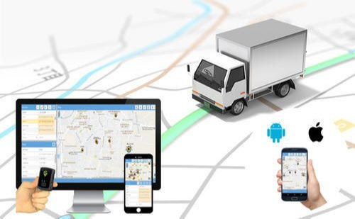
Nitte Meenakshi Institute of Technology (AN AUTONOMOUS INSTITUTION AFFILIATED TO VISVESVARAYA TECHNOLOGICAL UNIVERSITY, BELGAUM) PB No. 6429, Yelahanka, Bangalore 560-064, Karnataka Telephone: 080- 22167800, 22167860, Fax: 080 - 22167805 Department of Computer Science and Engineering ( NBA Accredited till 2020)
GPS Tracking
Live location of the driver can be visible in the dashboard using GPS Tracking. This system uses Node MCU and GPS module to fetch the live location of the vehicle taken on lease and displays to administrator he/she can easily monitor the live location of the vehicle in the real time basis.
Fig 2: GPS Tracking Example

Slide 17
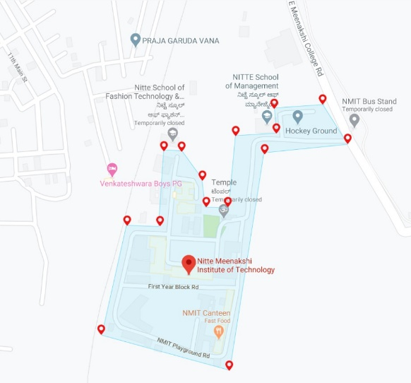
Nitte Meenakshi Institute of Technology (AN AUTONOMOUS INSTITUTION AFFILIATED TO VISVESVARAYA TECHNOLOGICAL UNIVERSITY, BELGAUM) PB No. 6429, Yelahanka, Bangalore 560-064, Karnataka Telephone: 080- 22167800, 22167860, Fax: 080 - 22167805 Department of Computer Science and Engineering ( NBA Accredited till 2020)
Geofencing
A geofence is an imaginary border drawn around a point by a GPS tracking system. Once a geofence is created, it can used as a trigger for alerts and events.
This system uses Google Map API to fence the geographical boundaries and show it on dashboard. It allows administrator to set up triggers for the vehicle so when vehicle enters/exits the boundaries an alert message is generated and sent to the administrator.
Fig 3: Geofencing Boundaries in Google Map

Slide 18
Nitte Meenakshi Institute of Technology (AN AUTONOMOUS INSTITUTION AFFILIATED TO VISVESVARAYA TECHNOLOGICAL UNIVERSITY, BELGAUM) PB No. 6429, Yelahanka, Bangalore 560-064, Karnataka Telephone: 080- 22167800, 22167860, Fax: 080 - 22167805 Department of Computer Science and Engineering ( NBA Accredited till 2020)
Vehicle Power Control ON/OFF
This system allows administrator to turn on/off the main power supply of an electric vehicle remotely. If the vehicle is parked in any remote location, then there is high chance of the vehicle being stolen. So, the control of the main power supply of an electrical vehicle can be handled directly by the administrator.
Relay sensor is used to switch on/off the main power supply. Remotely turning on/off doesn’t mean that without administrator driver can’t stop the vehicle. Starting/Stopping of the vehicle is fully done by driver. But just the main power supply which provide electricity to the vehicle is monitored by the administrator. Here before driver starts the vehicle, he/she needs to take permission from the administrator to turn on the main power supply. And after turning on the main power supply driver can start the vehicle. After ending the trip driver needs to inform the administrator the end of the trip and administrator will turn off the main power supply.

Slide 19
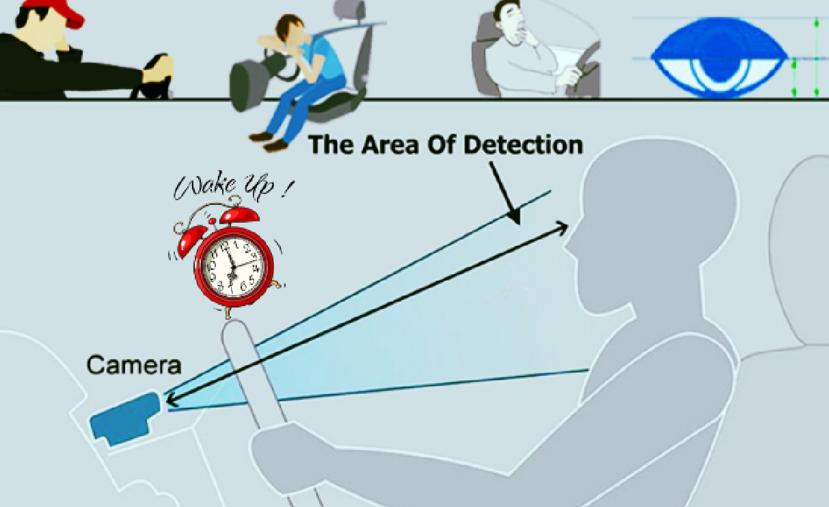
Nitte Meenakshi Institute of Technology (AN AUTONOMOUS INSTITUTION AFFILIATED TO VISVESVARAYA TECHNOLOGICAL UNIVERSITY, BELGAUM) PB No. 6429, Yelahanka, Bangalore 560-064, Karnataka Telephone: 080- 22167800, 22167860, Fax: 080 - 22167805 Department of Computer Science and Engineering ( NBA Accredited till 2020)
Drowsiness Detection
There might be situation where driver can get sleepy during the ride which can lead to accident. Such drowsiness can be detected using this system. This system will detect if the driver closes eyes for more than five seconds.
This system uses Machine Learning to fetch the EAR (Eye Accept Ratio) and alert driver if he/she closes eyes for more than 5 seconds. It will be annoying if the alarm keeps buzzing every time the driver blinks the eye.
Fig 4: Drowsiness Detecting

Slide 20
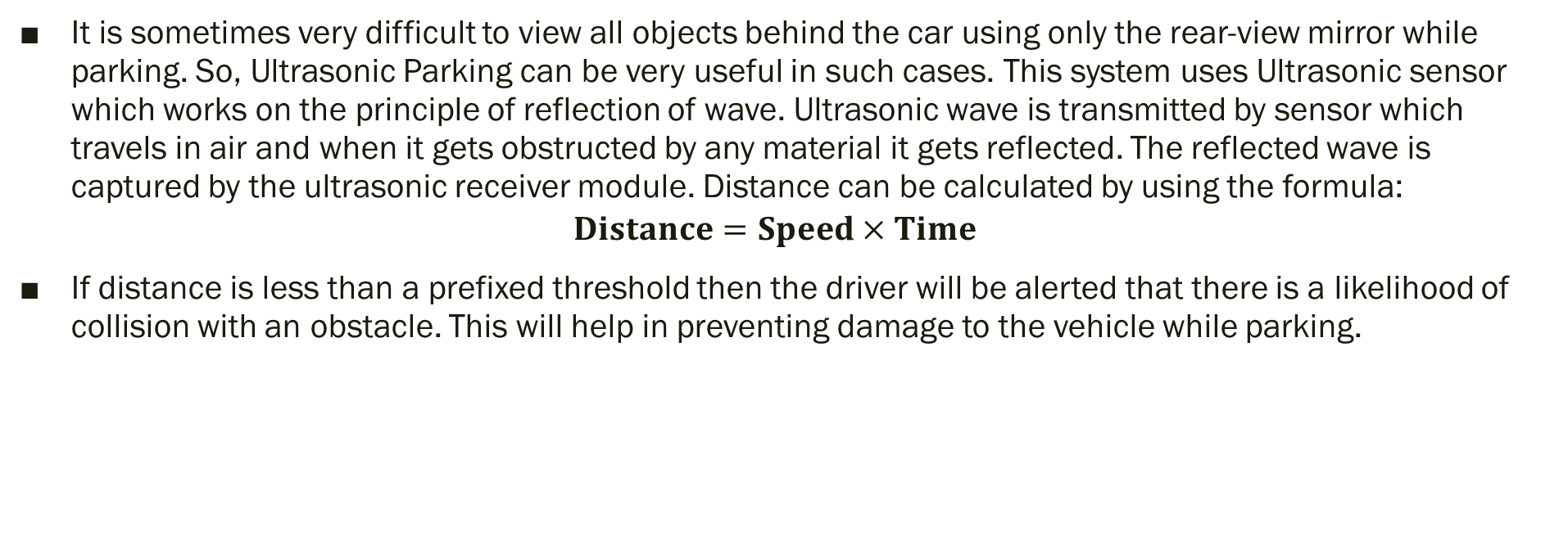
Nitte Meenakshi Institute of Technology (AN AUTONOMOUS INSTITUTION AFFILIATED TO VISVESVARAYA TECHNOLOGICAL UNIVERSITY, BELGAUM) PB No. 6429, Yelahanka, Bangalore 560-064, Karnataka Telephone: 080- 22167800, 22167860, Fax: 080 - 22167805 Department of Computer Science and Engineering ( NBA Accredited till 2020)
Ultrasonic Parking
It is sometimes very difficult to view all objects behind the car using only the rear-view mirror while parking. So, Ultrasonic Parking can be very useful in such cases. This system uses Ultrasonic sensor which works on the principle of reflection of wave. Ultrasonic wave is transmitted by sensor which travels in air and when it gets obstructed by any material it gets reflected. The reflected wave is captured by the ultrasonic receiver module. Distance can be calculated by using the formula:
$$Distance=Speed×Time$$
If distance is less than a prefixed threshold then the driver will be alerted that there is a likelihood of collision with an obstacle. This will help in preventing damage to the vehicle while parking.

Slide 21
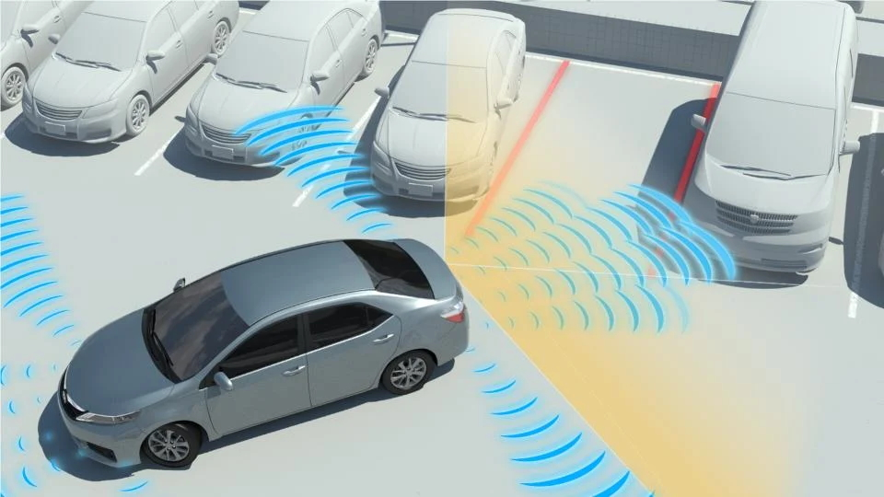
Nitte Meenakshi Institute of Technology (AN AUTONOMOUS INSTITUTION AFFILIATED TO VISVESVARAYA TECHNOLOGICAL UNIVERSITY, BELGAUM) PB No. 6429, Yelahanka, Bangalore 560-064, Karnataka Telephone: 080- 22167800, 22167860, Fax: 080 - 22167805 Department of Computer Science and Engineering ( NBA Accredited till 2020)
Ultrasonic Parking
Fig 5: Ultrasonic Parking Example

Slide 22
Nitte Meenakshi Institute of Technology (AN AUTONOMOUS INSTITUTION AFFILIATED TO VISVESVARAYA TECHNOLOGICAL UNIVERSITY, BELGAUM) PB No. 6429, Yelahanka, Bangalore 560-064, Karnataka Telephone: 080- 22167800, 22167860, Fax: 080 - 22167805 Department of Computer Science and Engineering ( NBA Accredited till 2020)
Speed Monitoring
Most of the accident nowadays occur due to over speed in India. Car Fleet Management allows the organization to monitor the current location as well as the speed of the vehicle on the administrator’s dashboard. If the speed of the car crosses the predefined limit then the driver will be alerted by the administrator. This can be implemented using accelerometer sensor. Using Raspberry pi and accelerometer sensor we can calculate the speed of the vehicle and display the speed on the dashboard of administrator.

Slide 23
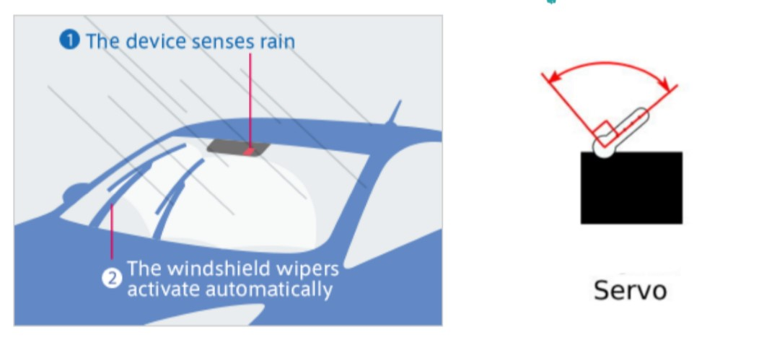
Nitte Meenakshi Institute of Technology (AN AUTONOMOUS INSTITUTION AFFILIATED TO VISVESVARAYA TECHNOLOGICAL UNIVERSITY, BELGAUM) PB No. 6429, Yelahanka, Bangalore 560-064, Karnataka Telephone: 080- 22167800, 22167860, Fax: 080 - 22167805 Department of Computer Science and Engineering ( NBA Accredited till 2020)
Automatic Wiper Control
Automatic Wiper can be one of the best examples of automatic vehicle component. This system helps driver not to worry much about the wiper switch. Whenever rain droplets fall on the rain sensor, servo motor will start rotating with an angle of 90°. By this the wiper will also turn on automatically.
Fig 5:Automatic Wiper and Servo Motor

Slide 24
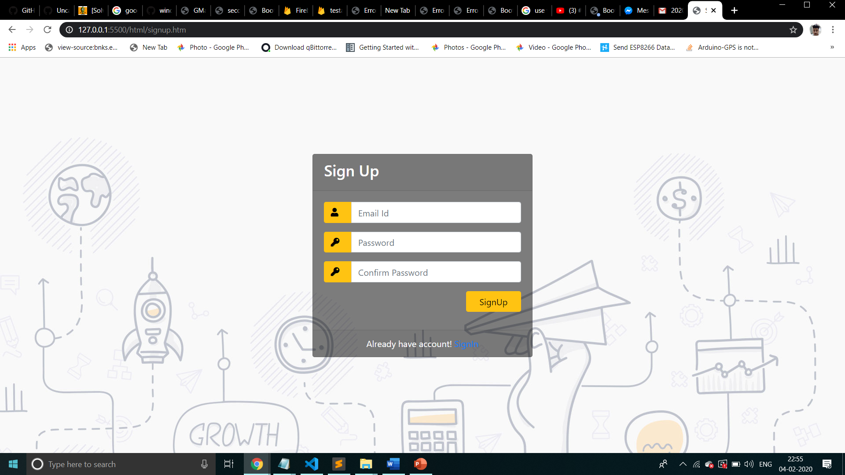
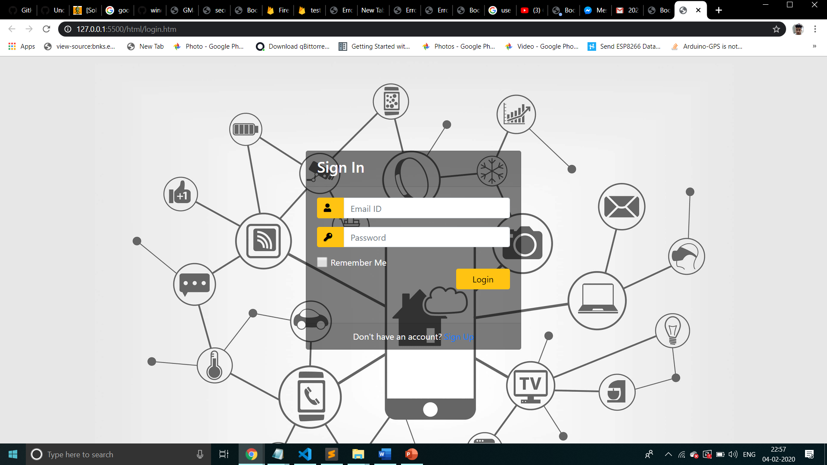
Nitte Meenakshi Institute of Technology (AN AUTONOMOUS INSTITUTION AFFILIATED TO VISVESVARAYA TECHNOLOGICAL UNIVERSITY, BELGAUM) PB No. 6429, Yelahanka, Bangalore 560-064, Karnataka Telephone: 080- 22167800, 22167860, Fax: 080 - 22167805 Department of Computer Science and Engineering ( NBA Accredited till 2020)
Output
Fig 6: Screenshot showing Sign Up page | Fig 7: Screenshot showing Sign In page

Slide 25
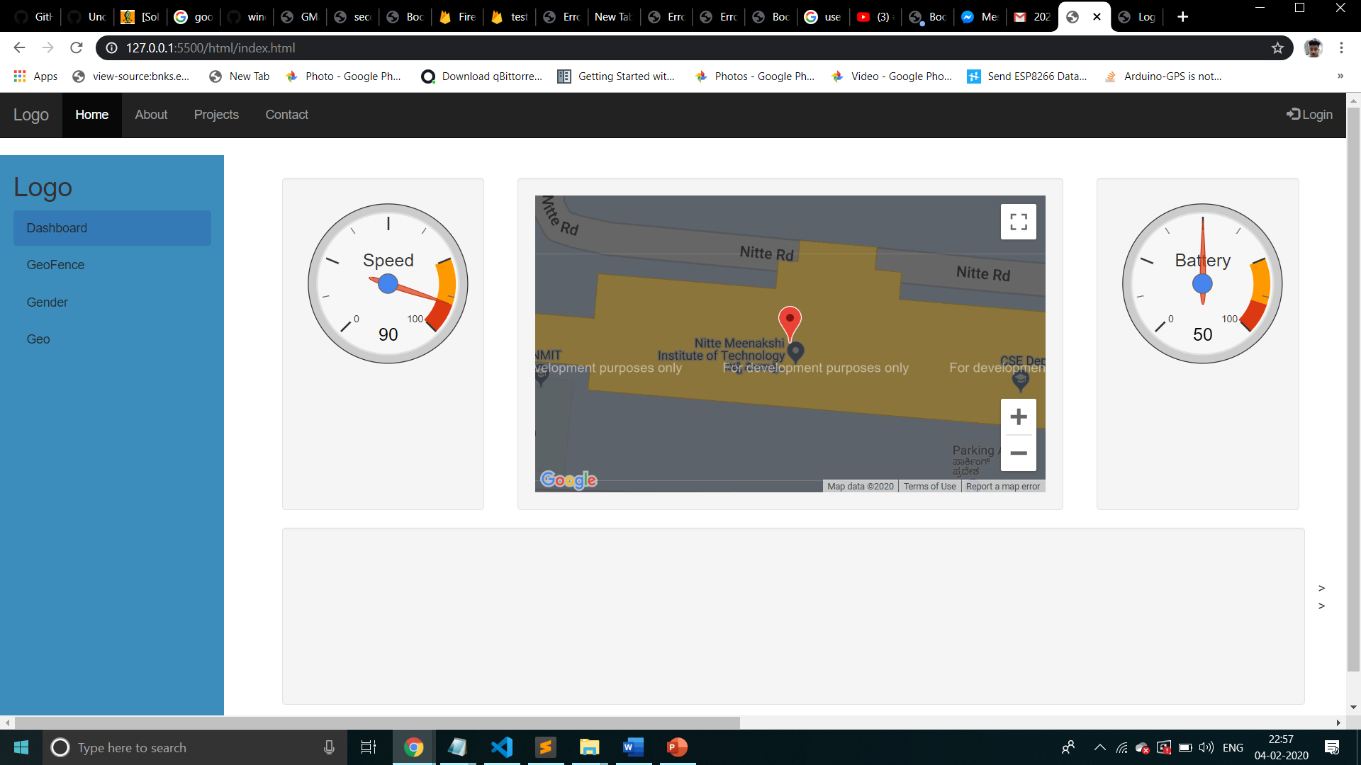
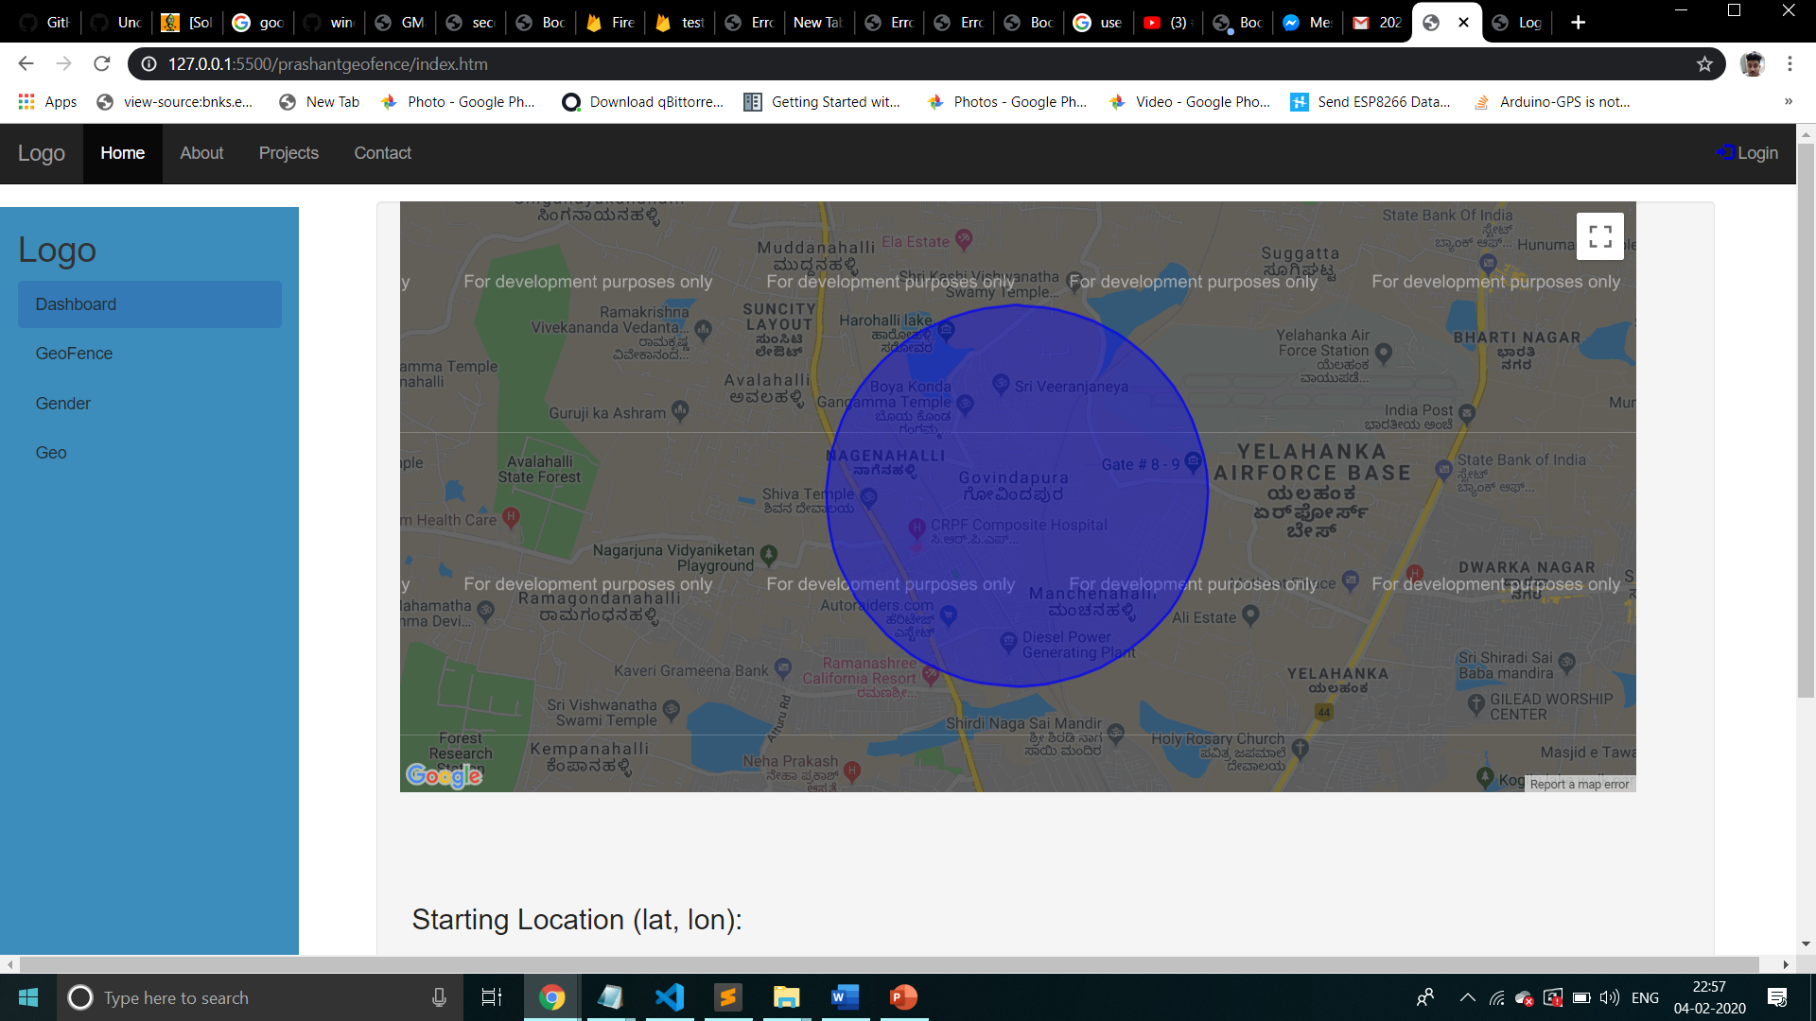
Nitte Meenakshi Institute of Technology (AN AUTONOMOUS INSTITUTION AFFILIATED TO VISVESVARAYA TECHNOLOGICAL UNIVERSITY, BELGAUM) PB No. 6429, Yelahanka, Bangalore 560-064, Karnataka Telephone: 080- 22167800, 22167860, Fax: 080 - 22167805 Department of Computer Science and Engineering ( NBA Accredited till 2020)
Output
Fig 8: Screenshot showing main dashboard | Fig 9: Screenshot showing Geofencing boundaries

Slide 26
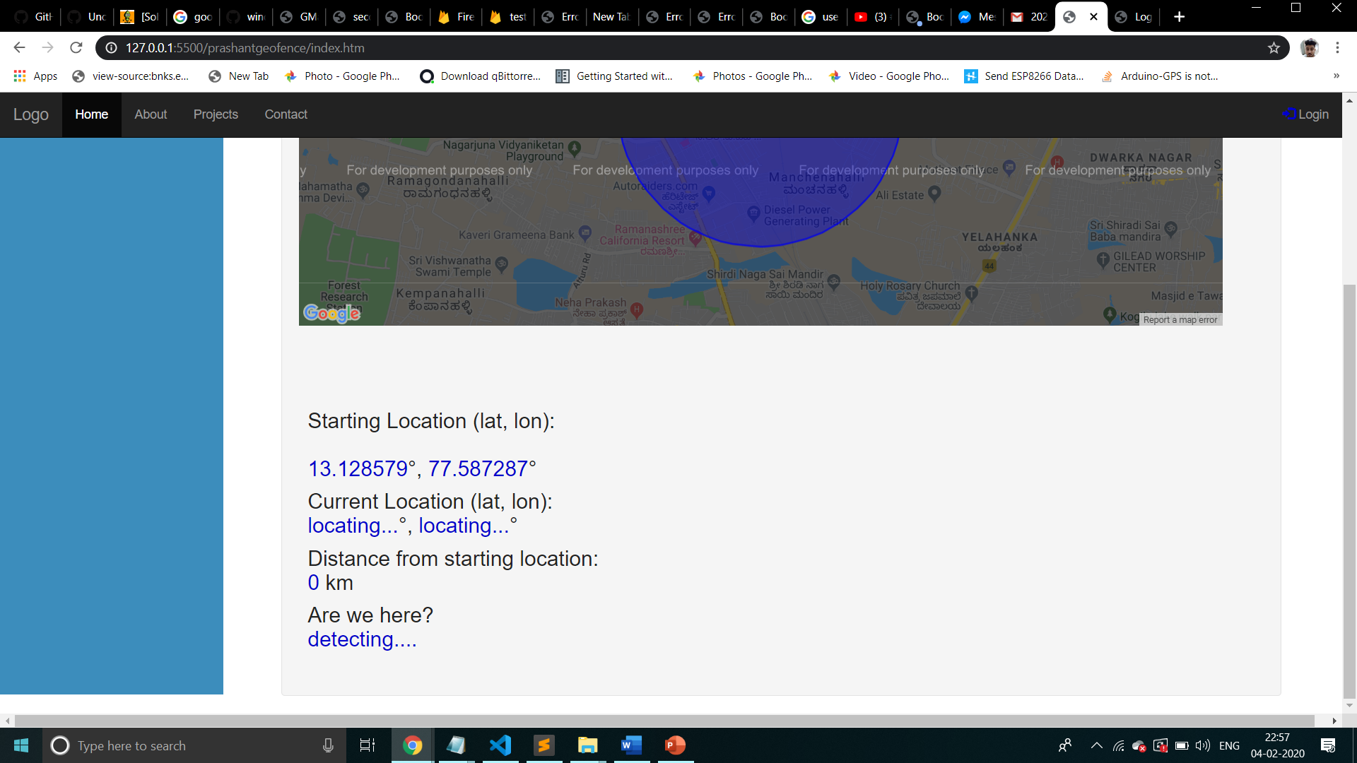
Nitte Meenakshi Institute of Technology (AN AUTONOMOUS INSTITUTION AFFILIATED TO VISVESVARAYA TECHNOLOGICAL UNIVERSITY, BELGAUM) PB No. 6429, Yelahanka, Bangalore 560-064, Karnataka Telephone: 080- 22167800, 22167860, Fax: 080 - 22167805 Department of Computer Science and Engineering ( NBA Accredited till 2020)
Output
Fig 10: Screenshot showing Geofencing result

Slide 27
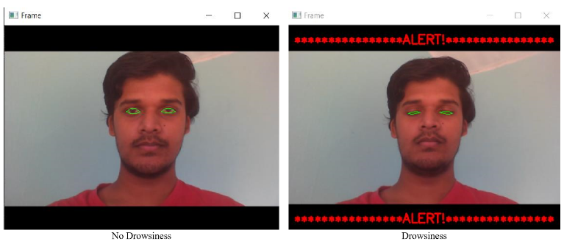
Nitte Meenakshi Institute of Technology (AN AUTONOMOUS INSTITUTION AFFILIATED TO VISVESVARAYA TECHNOLOGICAL UNIVERSITY, BELGAUM) PB No. 6429, Yelahanka, Bangalore 560-064, Karnataka Telephone: 080- 22167800, 22167860, Fax: 080 - 22167805 Department of Computer Science and Engineering ( NBA Accredited till 2020)
Output
Fig 11: Drowsiness detection result

Slide 28
Nitte Meenakshi Institute of Technology (AN AUTONOMOUS INSTITUTION AFFILIATED TO VISVESVARAYA TECHNOLOGICAL UNIVERSITY, BELGAUM) PB No. 6429, Yelahanka, Bangalore 560-064, Karnataka Telephone: 080- 22167800, 22167860, Fax: 080 - 22167805 Department of Computer Science and Engineering ( NBA Accredited till 2020)
Conclusion
This project aims to target the companies like Zoom car where they will be able to track and monitor their vehicle in real time and help to reduce the cost for maintenance since the vehicle information can be visible using IoT in the dashboard.
It will reduce the work of the fleet manager to a great extent as all activities are digitalized and automated. Every sensor acquires different type of data and sends it to the monitoring system. In monitoring system Firebase stores the data and the microcontroller processes all the data and again stores it in the firebase. After processing all the data, the information is visualized in the dashboard. Dashboard displays GPS location of the vehicle, Geofencing, Driver Drowsiness, Vehicle Power Control ON/OFF status, Wiper status. It just needs some manager to stay at backend and monitor the status of the vehicle. With the successful implementation of this system it can prove highly advantageous to organization. Regular update on the system after implementation can upgrade this proposed system and can be one of the best Car Feet Management System in future.

Slide 29
Nitte Meenakshi Institute of Technology (AN AUTONOMOUS INSTITUTION AFFILIATED TO VISVESVARAYA TECHNOLOGICAL UNIVERSITY, BELGAUM) PB No. 6429, Yelahanka, Bangalore 560-064, Karnataka Telephone: 080- 22167800, 22167860, Fax: 080 - 22167805 Department of Computer Science and Engineering ( NBA Accredited till 2020)
References
[1] Thiyagarajan Manihatty Bojan, Umamaheswaran Raman Kumar, and Viswanathan Manihatty Bojan, “An Internet of Things based Intelligent Transportation System”, 2014 IEEE International Conference on Vehicular Electronics and Safety (ICVES), December 16-17, 2014. Hyderabad, India [Available: IEEE Explore Org]
[2] Mahaveer Penna, Shivashankar, B Arjun, K R Goutham, Lohith N Madhaw, Kumar G Sanjay, “Smart fleet monitoring system using Internet of Things (IoT)”, 2017 2nd IEEE International Conference on Recent Trends in Electronics, Information & Communication Technology (RTEICT), 19-20 May 2017, Bangalore, India [Available: IEEE Explore Org]
[3] Channakeshava Gowda V R, Gopalakrishna K, “Real Time Vehicle Fleet Management and Security System”, 2015 IEEE Recent Advances in Intelligent Computational Systems (RAICS), 10-12 December 2015, Trivandrum [Available: IEEE Explore Org]

Slide 30
Nitte Meenakshi Institute of Technology (AN AUTONOMOUS INSTITUTION AFFILIATED TO VISVESVARAYA TECHNOLOGICAL UNIVERSITY, BELGAUM) PB No. 6429, Yelahanka, Bangalore 560-064, Karnataka Telephone: 080- 22167800, 22167860, Fax: 080 - 22167805 Department of Computer Science and Engineering ( NBA Accredited till 2020)
References
[4] Challa Yashwanth and Jyoti Singh Kirar, “Driver’s Drowsiness Detection”, 2019 IEEE Region 10 Conference (TENCON), Year 2019, Hyatt Kochi Bolgatti, Kerela, India [Available: IEEE Explore Org]
[5] R. Srinivasan, A. Sharmili, Dr. S. Saravanan, D. Jayaprakash, “Smart Vehicles with Everything”, 2016 2nd International Conference on Contemporary Computing and Informatics (IC3I), Year 2016, Salem, India [Available: IEEE Explore Org]
[6] Sarah Wilkinson, “Everything you need to know about Fleet Management” chevinfleet.com, para. 1, Sep. 25, 2018. [Online]. Available: https://www.chevinfleet.com/au/news/what-is-fleet-management-software. [Accessed Feb. 12, 2020].
[7] “HC-SR04 Ultrasonic Sensor” components101.com, para. 1 to 5, Sep. 18, 2017. [Online]. Available: https://components101.com/ultrasonic-sensor-working-pinout-datasheet. [Accessed Mar. 20, 2020].

Slide 31
Nitte Meenakshi Institute of Technology
(AN AUTONOMOUS INSTITUTION AFFILIATED TO VISVESVARAYA TECHNOLOGICAL UNIVERSITY, BELGAUM)
PB No. 6429, Yelahanka, Bangalore 560-064, Karnataka
Telephone: 080- 22167800, 22167860, Fax: 080 - 22167805
Department of Computer Science and Engineering
( NBA Accredited till 2020)
THANK YOU

